Slide 1
Lecture 5 Memory and storage
Computing platforms, semester 2
Novosibirsk State University University of Hertfordshire
D. Irtegov, A.Shafarenko
2019

Slide 2
Dynamic Random Access Memory

Slide 3
Mask Read-Only Memory
During chip manufacturing, some rows are connected to some columns, and others are not
Connected row/column read as one, disconnected as zero
To some degree, mask ROM is equivalent to combinatory circuits/PLA
Both take input bit string and produce output bit string
PLA need less gates than equivalent ROM when most values are zero.

Slide 4
Programmable ROM
Fuse PROM
Columns and rows connected by meltable resistors (fuses)
During programming, some fuses are melted by high voltage/current
After that, there is no way back (you can fuse 1 bits to 0, but not 0 to 1)
Erasable PROM
All industrially used EPROM types are built around floating gate transistor
Floating gate is charged by high voltage using quantum tunneling effect
But how to discharge it?
Ultraviolet erasable PROM (I really programmed those)
Electrically erasable PROM (even higher voltage used to discharge all gates on the chip)
Block erasable EEPROM is known as flash memory
There are programmable logical gate arrays (PGA) build using same approaches

Slide 5
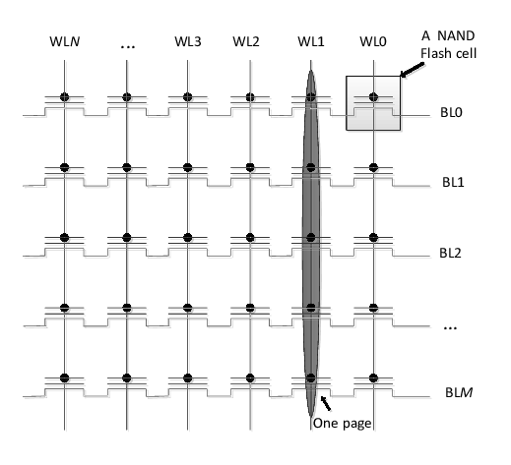
Modern flash memory
Most common type of flash memory is known as NAND memory
It has higher density than RAM-like circuits
All EPROM devices have limited number of write cycles
First generations of EEPROM had ~10 000 writes, modern flash has ~100 000 writes

Slide 6
Wear leveling
Memory is divided to large blocks (typically several megabytes)
Every block is divided to smaller pages (typically 512 bytes)
Logical pages are dynamically mapped to physical pages (mapping device is not on the picture)
When application writes to the page, flash controller selects an erased (free) page
When page is written again, controller selects another page and marks old one as garbage
When too many pages become garbage, non-garbage pages are evacuated to another block(s) and the block is erased.

Slide 7
More on wear leveling and garbage collection
Most applications (including operating systems) do not utilize all flash memory
If flash controller knows which pages are actually free, it does not need to evacuate them during garbage collection
There were attempts to build filesystem-aware SSD, but eventually TRIM/UNMAP commands were introduced to SATA/SAS standards
These commands allow filesystem to inform the SSD that page is no longer needed

Slide 8
Applications of flash memory
Main program memory and non-volatile data memory in embedded and mobile devices
Firmware in desktop and notebook computers
Specialized flash memory cards, like SD cards
Fast HDD emulators, like USB, SATA and SAS solid-state drives (SSD)
NVRAM storage In desktop and notebook computers (also behaves like block storage)

Slide 9
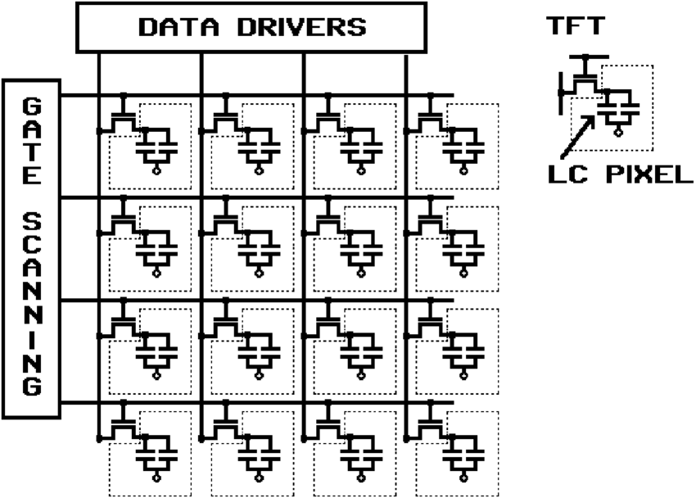
Another matrix-like electronic device
Liquid Crystal Display
Based on liquid crystals – substances that change optical properties in electric field
Every element of the display is a pair of electrodes. Electrically, it is a simple capacitor
Modern active matrix LCD have a transistor per element to speed up charge/discharge

Slide 10
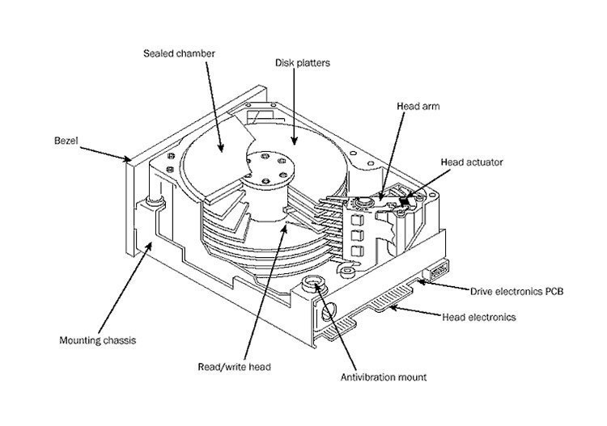
Magnetic storage
Most of data in the world are stored on magnetic storage, mostly hard disk drives
HDD is a complex device including mechanical moving parts, analog circuits and nontrivial digital sequential logic

Slide 11
Main components of HDD

Slide 12
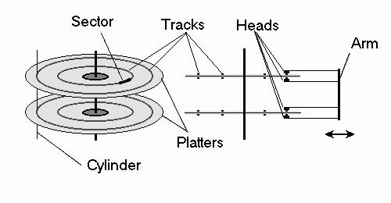
Logical structure of HDD storage
Disk consists of several plates
Every plate has two corresponding read/write magnetic heads (one per each side)
Every position of the arm correspond to a track/cylinder
Tracks are divided to sectors (typically 512 bytes)
Sectors can be read and written only as a whole thus the term ‘block device’

Slide 13
Evolution of HDD controllers
First generations of disks had relatively stupid controllers
Disk controller had commands like:
turn on motor,
move head to position 20,
read sector #15
Next generation of disks had complex processors with commands like: read sector from track 20, position 15
Next steps
Standard interfaces, like IDE/SATA and SCSI
Logical block addressing, when all surfaces and tracks were considered a linear sequence of sectors
Command queuing
LBA greatly simplified replacement of HDD with SSD

